Slide 1
Sequences and Series
Algebra 2
Chapter 12
Notes:
Algebra II 12

Slide 2
This Slideshow was developed to accompany the textbook
  Larson Algebra 2
  By Larson, R., Boswell, L., Kanold, T. D., & Stiff, L.
  2011 Holt McDougal
Some examples and diagrams are taken from the textbook.
Slides created by
Richard Wright, Andrews Academy
rwright@andrews.edu

Slide 3
12.1 Define and Use Sequences and Series
Sequence
  Function whose domain are integers
  List of numbers that follow a rule
  2, 4, 6, 8, 10
    Finite
  2, 4, 6, 8, 10, …
    Infinite
Notes:
n is like x, a_{n} is like y

Slide 4

12.1 Define and Use Sequences and Series
Rule
  $a_{n}=2n$
Domain: (n)
  Term’s location (1st, 2nd, 3rd…)
Range: (a_{n})
  Term’s value (2, 4, 6, 8…)

Slide 5


12.1 Define and Use Sequences and Series
Writing rules for sequences
  Look for patterns
  Guess-and-check
$\frac{2}{5},\frac{2}{25},\frac{2}{125},\frac{2}{625},…$
  $\frac{2}{5^{1}},\frac{2}{5^{2}},\frac{2}{5^{3}},\frac{2}{5^{4}}, …$
  $a_{n}=\frac{2}{5^{n}}$
3, 5, 7, 9, …
  $2\left(1\right)+1,$
  $2\left(2\right)+1,$
  $2\left(3\right)+1, …$
  $a_{n}=2n+1$
Notes:
2/5¹, 2/5², 2/5³, 2/5⁴, … → a_{n} = 2/5^{n}
2(1)+1, 2(2)+1, 2(3)+1, … → a_{n} = 2n + 1

Slide 6
12.1 Define and Use Sequences and Series
To graph
  n is like x; a_{n} is like y
  The graph will be dots
    Do NOT connect the dots
Notes:
The n’s are integers so there is no values between the integers.

Slide 7
12.1 Define and Use Sequences and Series
Series
  Sum of a sequence
  2, 4, 6, 8, … → sequence
  2 + 4 + 6 + 8 + · · · → series

Slide 8

12.1 Define and Use Sequences and Series
Sigma notation
  Finite
    $$2+4+6+8=\sum_{i=1}^{4}{2i}$$
  Infinite
    $$2+4+6+8+⋯=\sum_{i=1}^{∞}{2i}$$
Upper limit
Lower limit
Index of summation (variable)

Slide 9
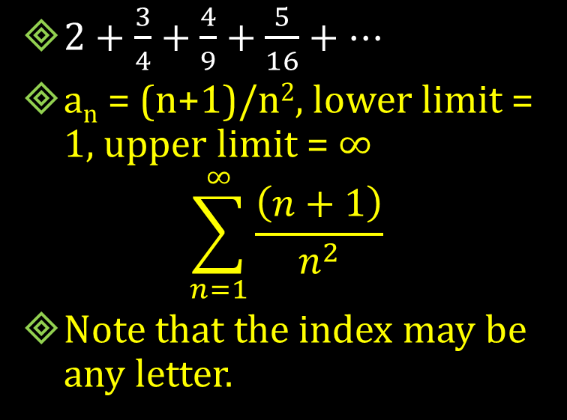
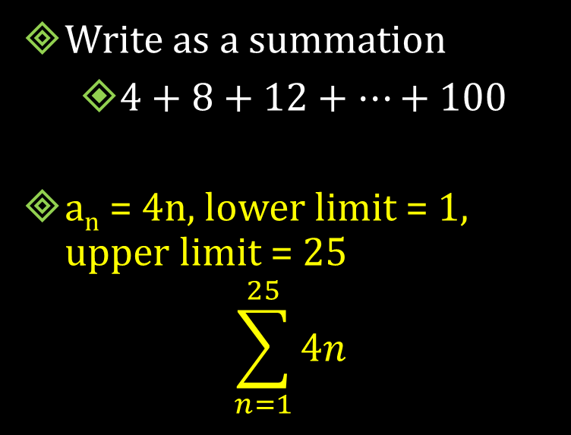
12.1 Define and Use Sequences and Series
Write as a summation
  $4+8+12+⋯+100$
a_{n} = 4n, lower limit = 1, upper limit = 25
$$\sum_{n=1}^{25}{4n}$$
  $2+\frac{3}{4}+\frac{4}{9}+\frac{5}{16}+⋯$
  a_{n} = (n+1)/n², lower limit = 1, upper limit = ∞
  $$\sum_{n=1}^{∞}{\frac{\left(n+1\right)}{n^{2}}}$$
  Note that the index may be any letter.
Notes:
a_{n} = 4n, lower limit = 1, upper limit = 25
$$\sum_{n=1}^{25}{4n}$$
a_{n} = (n+1)/n², lower limit = 1, upper limit = ∞
$$\sum_{n=1}^{∞}{\frac{\left(n+1\right)}{n^{2}}}$$
Note that the index may be any letter.

Slide 10

12.1 Define and Use Sequences and Series
Find the sum of the series
$$\sum_{k=5}^{10}{k^{2}}+1$$
$\left(5^{2}+1\right)+\left(6^{2}+1\right)+\left(7^{2}+1\right)+\left(8^{2}+1\right)+\left(9^{2}+1\right)+\left({10}^{2}+1\right)$
$=361$
Notes:
5² + 1 + 6² + 1 + 7² + 1 + 8² +1 + 9² + 1 + 10² + 1 = 361

Slide 11

12.1 Define and Use Sequences and Series
Some shortcut formulas
$$\sum_{i=1}^{n}{1}=n$$
$$\sum_{i=1}^{n}{i}=\frac{n\left(n+1\right)}{2}$$
$$\sum_{i=1}^{n}{i^{2}}=\frac{n\left(n+1\right)\left(2n+1\right)}{6}$$

Slide 12

12.1 Define and Use Sequences and Series
Find the sum of the series
$$\sum_{k=1}^{10}{3k^{2}}+2$$
$3\frac{n\left(n+1\right)\left(2n+1\right)}{6}+2n$
$3\frac{10\left(10+1\right)\left(2\left(10\right)+1\right)}{6}+2\left(10\right)$
$=1175$
Notes:
$$3\frac{n\left(n+1\right)\left(2n+1\right)}{6}+2n=3\frac{10\left(10+1\right)\left(2\left(10\right)+1\right)}{6}+2\left(10\right)=1175$$

Slide 13
Quiz
12.1 Homework Quiz

Slide 14

12.2 Analyze Arithmetic Sequences and Series
Arithmetic Sequences
  Common difference (d) between successive terms
    Add the same number each time
  3, 6, 9, 12, 15, …
    d = 3
Is it arithmetic?
  -10, -6, -2, 0, 2, 6, 10, …
    No
  5, 11, 17, 23, 29, …
    Yes, $d=6$
Notes:
No
Yes, d = 6

Slide 15
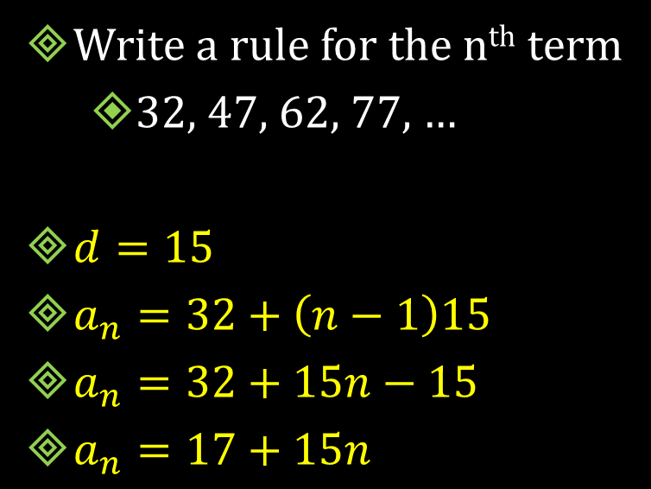

12.2 Analyze Arithmetic Sequences and Series
Formula for n^{th} term
  $a_{n}=a_{1}+\left(n−1\right)d$
Write a rule for the n^{th} term
  32, 47, 62, 77, …
$d=15$
$a_{n}=32+\left(n−1\right)15$
$a_{n}=32+15n−15$
$a_{n}=17+15n$
Notes:
d = 15
a_{n} = 32+(n-1)15 = 32+15n-15 → a_{n} = 17 + 15n

Slide 16
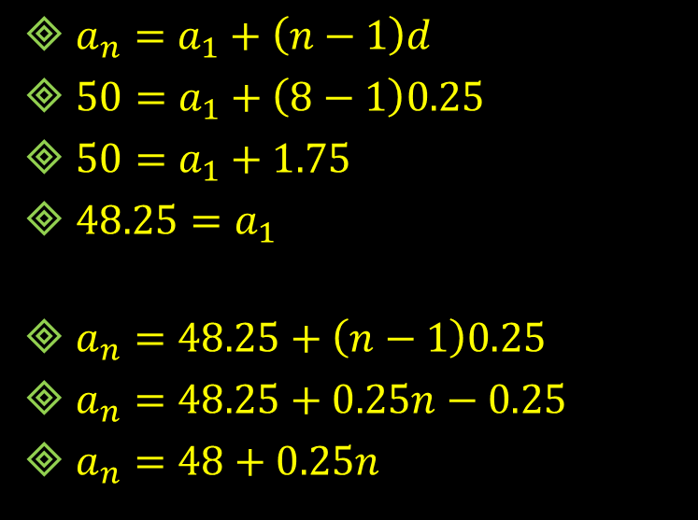
12.2 Analyze Arithmetic Sequences and Series
One term of an arithmetic sequence is a₈ = 50. The common difference is 0.25. Write the rule for the n^{th} term.
$a_{n}=a_{1}+\left(n−1\right)d$
$50=a_{1}+\left(8−1\right)0.25$
$50=a_{1}+1.75$
$48.25=a_{1}$
$a_{n}=48.25+\left(n−1\right)0.25$
$a_{n}=48.25+0.25n−0.25$
$a_{n}=48+0.25n$
Notes:
a_{n} = a₁ + (n – 1)d
50 = a₁ + (8 – 1)0.25 → 50 = a₁ + 1.75 → 48.25 = a₁
a_{n} = 48.25 + (n – 1)0.25 → a_{n} = 48.25 + 0.25n – 0.25 → a_{n} = 48 + 0.25n

Slide 17
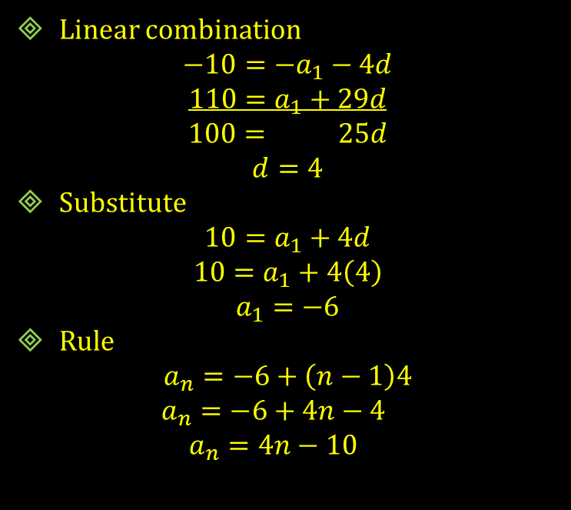

12.2 Analyze Arithmetic Sequences and Series
Two terms of an arithmetic sequence are a₅ = 10 and a₃₀ = 110. Write a rule for the n^{th} term.
$a_{n}=a_{1}+\left(n−1\right)d$
$10=a_{1}+\left(5−1\right)d$
  $10=a_{1}+4d$
$110=a_{1}+\left(30−1\right)d$
  $110= a_{1}+29d$
Linear combination
$$−10=−a_{1}−4d$$
$$110=a_{1}+29d$$
$$100= 25d$$
$$d=4$$
Substitute
$$10=a_{1}+4d$$
$$10=a_{1}+4\left(4\right)$$
$$a_{1}=−6$$
Rule
$$a_{n}=−6+\left(n−1\right)4$$
$$a_{n}=−6+4n−4$$
$$a_{n}=4n−10$$
Notes:
a_{n} = a₁ + (n – 1)d
10 = a₁ + (5 – 1)d → 10 = a₁ + 4d
110 = a₁ + (30 – 1)d → 110 = a₁ + 29d
Linear combination
-10 = -a₁ – 4d
110 = a₁ + 29d
100 = 25 d
d = 4
Substitute
= a₁ + 4d → 10 = a₁ + 4(4) → a₁ = -6
Rule
a_{n} = -6 +(n – 1)4 → a_{n} = -6 + 4n – 4 → a_{n} = 4n - 10

Slide 18
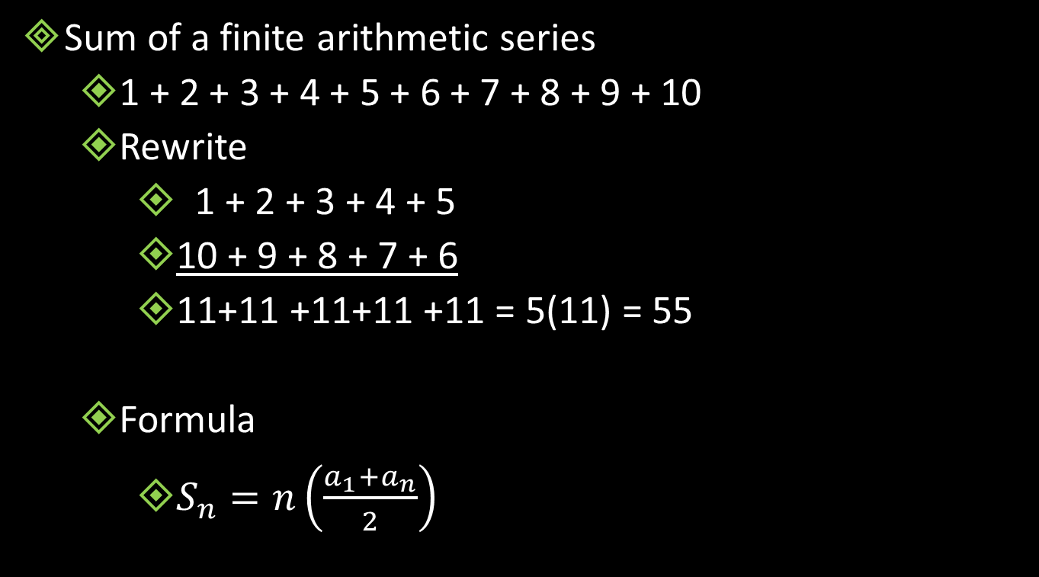
12.2 Analyze Arithmetic Sequences and Series
Sum of a finite arithmetic series
  1 + 2 + 3 + 4 + 5 + 6 + 7 + 8 + 9 + 10
  Rewrite
    1 + 2 + 3 + 4 + 5
    10 + 9 + 8 + 7 + 6
    11+11 +11+11 +11 = 5(11) = 55
  Formula
    $S_{n}=n\left(\frac{a_{1}+a_{n}}{2}\right)$
Notes:
From example:
First and last (a₁ + a_{n}) = 11
10 numbers but only half as many pairs (n/2)

Slide 19
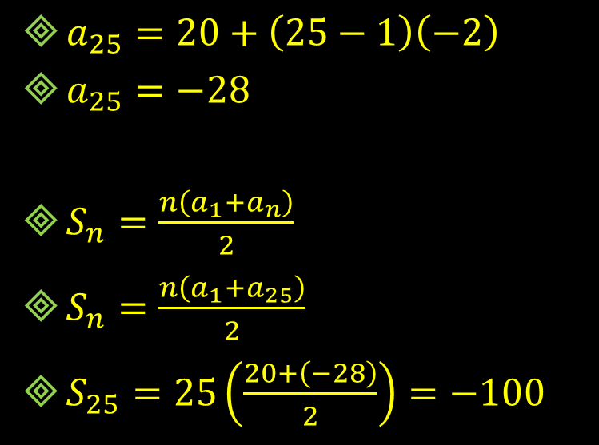
12.2 Analyze Arithmetic Sequences and Series
Consider the arithmetic series
  20 + 18 + 16 + 14 + ···
Find the sum of the first 25 terms.
$a_{25}=20+\left(25−1\right)\left(−2\right)$
$a_{25}=−28$
$S_{n}=\frac{n\left(a_{1}+a_{n}\right)}{2}$
$S_{n}=\frac{n\left(a_{1}+a_{25}\right)}{2}$
$S_{25}=25\left(\frac{20+\left(−28\right)}{2}\right)=−100$
Notes:
a₂₅ = 20 + (25-1)(-2) = -28
S₂₅ = 25((20+-28)/2) = -100

Slide 20
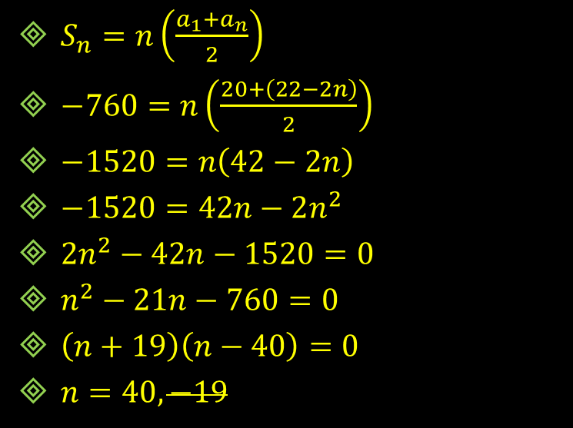

12.2 Analyze Arithmetic Sequences and Series
Consider the arithmetic series
  20 + 18 + 16 + 14 + ···
Find n such that $S_{n}=−760$
$S_{n}=n\left(\frac{a_{1}+a_{n}}{2}\right)$
$a_{n}=20+\left(n−1\right)\left(−2\right)$
$a_{n}=22−2n$
$S_{n}=n\left(\frac{a_{1}+a_{n}}{2}\right)$
$−760=n\left(\frac{20+\left(22−2n\right)}{2}\right)$
$−1520=n\left(42−2n\right)$
$−1520=42n−2n^{2}$
$2n^{2}−42n−1520=0$
$n^{2}−21n−760=0$
$\left(n+19\right)\left(n−40\right)=0$
$n=40, −19$
Notes:
a_{n} = 20 + (n-1)(-2) = 22 – 2n
S_{n} = -760 = n((20 + 22 – 2n)/2) → -1520 = n(42 – 2n) → -1520 = 42n – 2n² → 2n² – 42n – 1520 = 0 → n² – 21n – 760 = 0 → (n+19)(n-40) = 0 → n = 40, -19

Slide 21
Quiz
12.2 Homework Quiz

Slide 22

12.3 Analyze Geometric Sequences and Series
Created by multiplying by a common ratio (r)
Are these geometric sequences?
  1, 2, 6, 24, 120, …
    No
  81, 27, 9, 3, 1, …
    Yes, $r=\frac{1}{3}$
Notes:
No
Yes r = 1/3

Slide 23
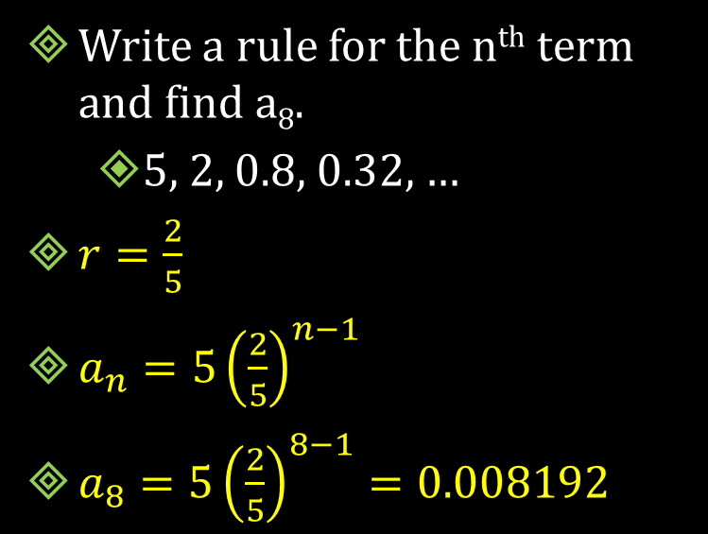

12.3 Analyze Geometric Sequences and Series
Formula for n^{th} term
  $a_{n}=a_{1}·r^{n−1}$
Write a rule for the n^{th} term and find a₈.
  5, 2, 0.8, 0.32, …
$r=\frac{2}{5}$
$a_{n}=5{\left(\frac{2}{5}\right)}^{n−1}$
$a_{8}=5{\left(\frac{2}{5}\right)}^{8−1}=0.008192$
Notes:
r = 2/5
a_{n} = 5(2/5)^{n-1}
a₈ = 5(2/5)⁷ = 0.008192

Slide 24

12.3 Analyze Geometric Sequences and Series
One term of a geometric sequence is a₄ = 3 and r = 3. Write the rule for the n^{th} term.
$a_{n}=a_{1}r^{n−1}$
$3=a_{1}3^{4−1}$
$3=a_{1}27$
$a_{1}=\frac{1}{9}$
$a_{n}=\left(\frac{1}{9}\right)3^{n−1}$
Notes:
a₄ = 3 = a₁3⁴⁻¹ → 3 = a₁ 27 → a₁ = 1/9
a_{n} = (1/9) 3^{n-1}

Slide 25
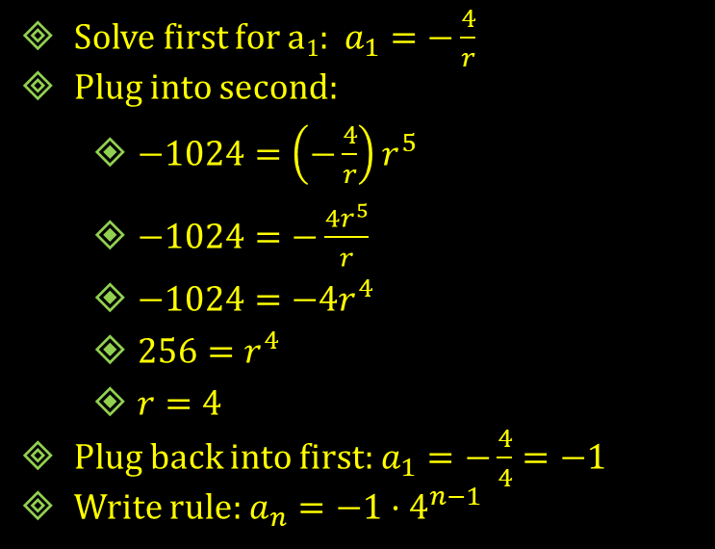

12.3 Analyze Geometric Sequences and Series
If two terms of a geometric sequence are $a_{2}=−4$ and $a_{6}=−1024$, write rule for the n^{th} term.
$a_{n}=a_{1}r^{n−1}$
$−4 = a_{1}r^{2−1}$
  $−4 = a_{1}r$
$−1024=a_{1}r^{6−1}$
  $−1024=a_{1}r^{5}$
Solve first for a₁: $a_{1}=−\frac{4}{r}$
Plug into second:
  $−1024=\left(−\frac{4}{r}\right)r^{5}$
  $−1024=−\frac{4r^{5}}{r}$
  $−1024=−4r^{4}$
  $256=r^{4}$
  $r=4$
Plug back into first: $a_{1}=−\frac{4}{4}=−1$
Write rule: $a_{n}=−1·4^{n−1}$
Notes:
a₂ = -4 = a₁ r²⁻¹ → -4 = a₁ r
a₆ = -1024 = a₁ r⁶⁻¹ → -1024 = a₁ r⁵
Solve first for a₁: a₁ = -4/r
Plug into second: -1024 = (-4/r)r⁵ → -1024 = -4r⁵/r → -1024 = -4r⁴ → 256 = r⁴ → r = 4
Plug back into first: a₁ = -4/4 → a₁ = -1
Write rule: a_{n} = -1·4^{n-1}

Slide 26


12.3 Analyze Geometric Sequences and Series
Sum of geometric series
  $S_{n}=a_{1}\left(\frac{1−r^{n}}{1−r}\right)$
Find the sum of the first 10 terms of
  4 + 2 + 1 + ½ + ···
$r=\frac{1}{2}, a_{1}=4$
$S_{10}=4\left(\frac{\left(1−{\left(\frac{1}{2}\right)}^{10}\right)}{1−\frac{1}{2}}\right)$
$=4\left(\frac{.99902}{.5}\right)$
$=\frac{1023}{128}=7.992$
Notes:
r = ½, a₁ = 4
S₁₀ = 4((1 – (½)¹⁰)/(1 – ½)) = 4(.99902/.5) = 7.992 = 1023/128

Slide 27


12.3 Analyze Geometric Sequences and Series
Find n such that $S_{n}=\frac{31}{4}$
  4 + 2 + 1 + ½ + ···
$S_{n}=a_{1}\left(\frac{1−r^{n}}{1−r}\right)$
$\frac{31}{4}=4\left(\frac{1−{\left(\frac{1}{2}\right)}^{n}}{1−\frac{1}{2}}\right)$
$\frac{31}{16}=\frac{1−{\left(\frac{1}{2}\right)}^{n}}{\frac{1}{2}}$
$\frac{31}{32}=1−{\left(\frac{1}{2}\right)}^{n}$
$−\frac{1}{32}=−{\left(\frac{1}{2}\right)}^{n}$
$\frac{1}{32}={\left(\frac{1}{2}\right)}^{n}$
$\log_{1/2}\left(\frac{1}{32}\right)=n\log_{1/2}\left(\frac{1}{2}\right)$
$5=n$
Notes:
31/4 = 4((1 – (1/2)^{n})/(1-1/2)) → 31/16 = (1 – (1/2)^{n})/(1/2) → 31/32 = 1 – (1/2)^{n} → -1/32 = -(1/2)^{n} → 1/32 = (1/2)^{n} → log (1/32) = n log (1/2) → n = (log (1/32)/log (1/2)) = 5

Slide 28
Quiz
12.3 Homework Quiz

Slide 29
12.4 Find the Sums of Infinite Geometric Series
Notes:
Think of the box a 1 whole piece

Slide 30

12.4 Find the Sums of Infinite Geometric Series
$$\frac{1}{2}$$
Notes:
Cut in half

Slide 31
12.4 Find the Sums of Infinite Geometric Series
$$\frac{1}{2}$$
$$\frac{1}{2}$$
Notes:
Cut in half

Slide 32

12.4 Find the Sums of Infinite Geometric Series
$$\frac{1}{2}$$
$$\frac{1}{4}$$
$$\frac{1}{2}+\frac{1}{4}$$
Notes:
Cut in half

Slide 33

12.4 Find the Sums of Infinite Geometric Series
$$\frac{1}{8}$$
$$\frac{1}{2}$$
$$\frac{1}{4}$$
$$\frac{1}{2}+\frac{1}{4}+\frac{1}{8}$$
Notes:
Cut in half

Slide 34

12.4 Find the Sums of Infinite Geometric Series
$$\frac{1}{8}$$
$$\frac{1}{2}$$
$$\frac{1}{16}$$
$$\frac{1}{4}$$
$$\frac{1}{2}+\frac{1}{4}+\frac{1}{8}+\frac{1}{16}$$
Notes:
Cut in half

Slide 35


12.4 Find the Sums of Infinite Geometric Series
$$\frac{1}{32}$$
$$\frac{1}{8}$$
$$\frac{1}{2}$$
$$\frac{1}{16}$$
What is the sum of the pieces if we keep cutting forever?
$$\frac{1}{4}$$
$$\frac{1}{2}+\frac{1}{4}+\frac{1}{8}+\frac{1}{16}+\frac{1}{32}$$
Notes:
What is the sum of the pieces if we keep going? 1 piece

Slide 36

12.4 Find the Sums of Infinite Geometric Series
Sum of an infinite geometric series
  $S=\frac{a_{1}}{1−r}$
| r | < 1
  If | r | > 1, then no sum (∞)

Slide 37


12.4 Find the Sums of Infinite Geometric Series
Find the sum
$$\sum_{i=1}^{∞}{2{\left(0.1\right)}^{i−1}}$$
$a_{1}=2{\left(0.1\right)}^{1−1}=2,$
$r=0.1$
$S=\frac{a_{1}}{1−r}$
$S=\frac{2}{1−0.1}$
$S=\frac{2}{0.9}=\frac{20}{9}$
$12+4+\frac{4}{3}+\frac{4}{9}+⋯$
$a_{1}=12, r=\frac{1}{3}$
$S=\frac{a_{1}}{1−r}$
$S=\frac{12}{1−\frac{1}{3}}$
$S=\frac{12}{\frac{2}{3}}$
$S=18$
Notes:
a₁ = 2(0.1)¹⁻¹ = 2, r = 0.1
S=2/(1-0.1) = 2/.9 = 20/9
a₁ = 12, r = 1/3
S=12/(1-1/3) = 12/(2/3) = 36/2 = 18

Slide 38


12.4 Find the Sums of Infinite Geometric Series
An infinite geometric series has a₁ = 5 has sum of 27/5. Find the common ratio.
$S=\frac{a_{1}}{1−r}$
$\frac{27}{5}=\frac{5}{1−r}$
$27\left(1−r\right)=25$
$1−r=\frac{25}{27}$
$−r=−\frac{2}{27}$
$r=\frac{2}{27}$
Notes:
27/5 = 5/(1-r) → 27(1-r) = 5*5 → 1-r = 25/27 → -r = -2/27 → r = 2/27

Slide 39

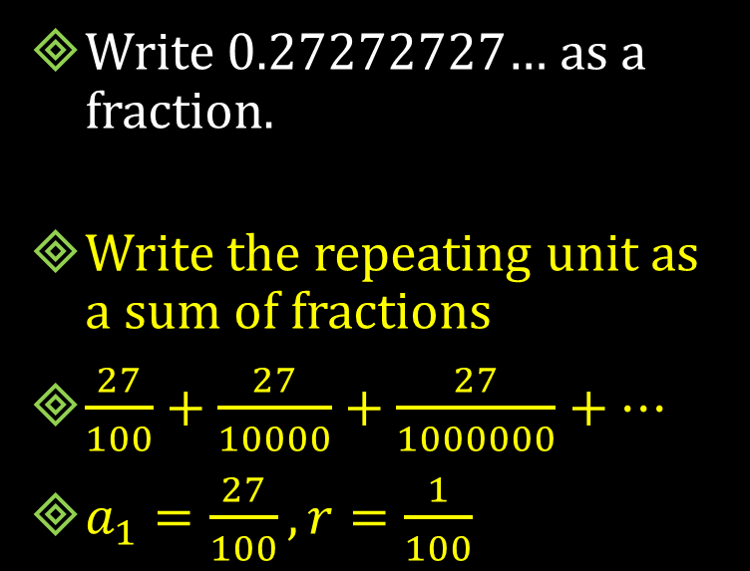
12.4 Find the Sums of Infinite Geometric Series
Write 0.27272727… as a fraction.
Write the repeating unit as a sum of fractions
$\frac{27}{100}+\frac{27}{10000}+\frac{27}{1000000}+…$
$a_{1}=\frac{27}{100}, r=\frac{1}{100}$
$S=\frac{\frac{27}{100}}{1−\left(\frac{1}{100}\right)}$
$S=\frac{\frac{27}{100}}{\frac{99}{100}}$
$S=\frac{27}{99}$
$S=\frac{3}{11}$
Notes:
Write the repeating unit as a sum of fractions
27/100 + 27/10000 + 27/1000000 + …
a₁ = 27/100, r = 1/100
S = (27/100)/(1-(1/100)) = (27/100)/(99/100) = 27/99 = 3/11

Slide 40

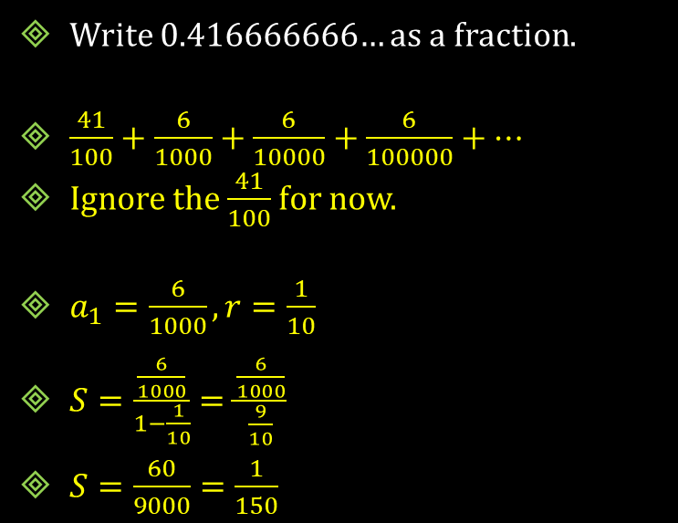
12.4 Find the Sums of Infinite Geometric Series
Write 0.416666666… as a fraction.
$\frac{41}{100}+\frac{6}{1000}+\frac{6}{10000}+\frac{6}{100000}+…$
Ignore the $\frac{41}{100}$ for now.
$a_{1}=\frac{6}{1000}, r=\frac{1}{10}$
$S=\frac{\frac{6}{1000}}{1−\frac{1}{10}}=\frac{\frac{6}{1000}}{\frac{9}{10}}$
$S=\frac{60}{9000}=\frac{1}{150}$
Now add the $\frac{41}{100}$
$\frac{41}{100}+\frac{1}{150}$
$\frac{41∗3}{300}+\frac{1∗2}{300}$
$\frac{123}{300}+\frac{2}{300}$
$\frac{125}{300}=\frac{5}{12}$
Notes:
41/100 + 6/1000 + 6/10000 + 6/100000 + …
Ignore the 41/100 for now.
a₁ = 6/1000, r = 1/10
S = (6/1000)/(1-1/10) = (6/1000)/(9/10) = 60/9000 = 1/150
Now add the 41/100
41/100 + 1/150 → (41*3)/300 + (1*2)/300 → 123/300 + 2/300 → 125/300 → 5/12

Slide 41
Quiz
12.4 Homework Quiz

Slide 42
12.5 Use Recursive Rules with Sequences and Functions
Explicit Rule
  Gives the n^{th} term directly
  a_{n} = 2 + 4n
Recursive Rule
  Each term is found by knowing the previous term
  a₁ = 6; a_{n} = a_{n-1} + 4
Notes:
Both these rules give the same sequence

Slide 43
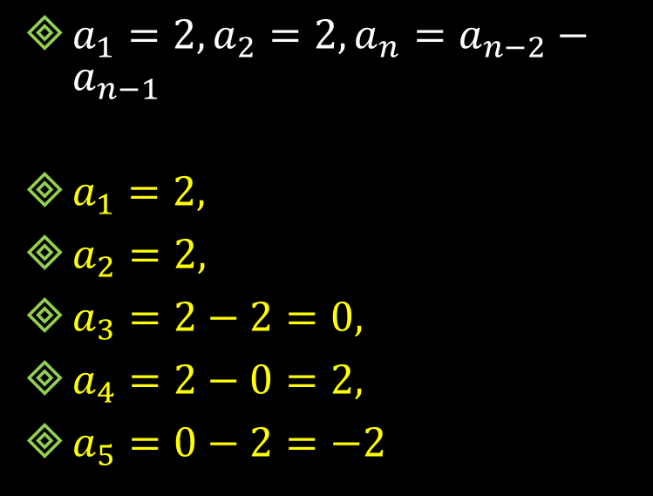
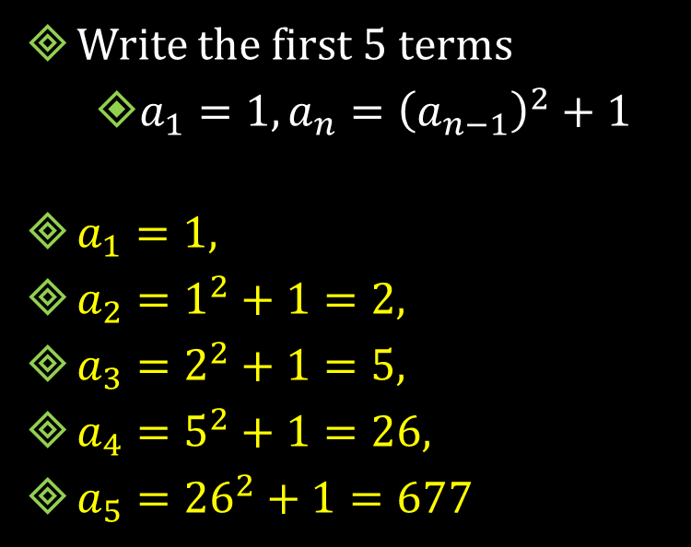
12.5 Use Recursive Rules with Sequences and Functions
Write the first 5 terms
  $a_{1}=1, a_{n}={\left(a_{n−1}\right)}^{2}+1$
$a_{1}=1,$
$a_{2}=1^{2}+1=2,$
$a_{3}=2^{2}+1=5,$
$a_{4}=5^{2}+1=26,$
$a_{5}={26}^{2}+1=677$
  $a_{1}=2, a_{2}=2, a_{n}=a_{n−2}−a_{n−1}$
$a_{1}=2,$
$a_{2}=2,$
$a_{3}=2−2=0,$
$a_{4}=2−0=2,$
$a_{5}=0−2=−2$
Notes:
a₁ = 1, a₂ = 1² + 1 = 2, a₃ = 2² + 1 = 5, a₄ = 5² + 1 = 26, a₅ = 26² + 1 677
a₁ = 2, a₂ = 2, a₃ = 2-2 = 0, a₄ = 2 – 0 = 2, a₅ = 0 – 2 = -2

Slide 44

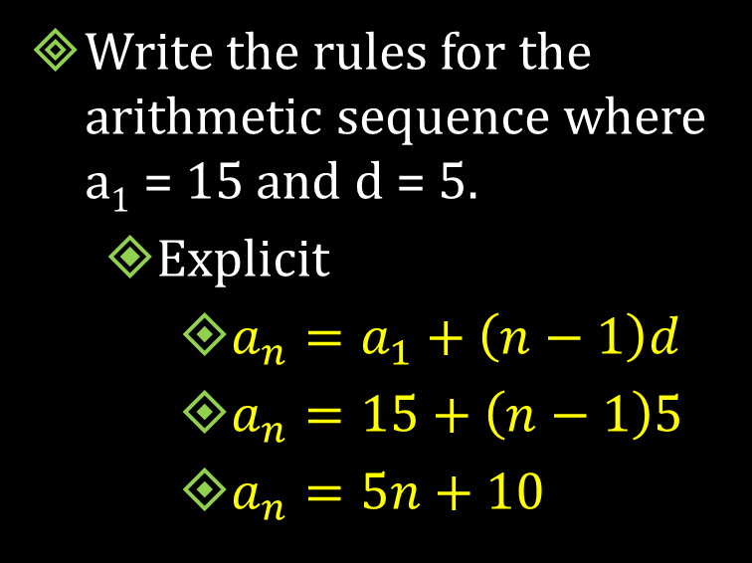
12.5 Use Recursive Rules with Sequences and Functions
Write the rules for the arithmetic sequence where a₁ = 15 and d = 5.
  Explicit
    $a_{n}=a_{1}+\left(n−1\right)d$
    $a_{n}=15+\left(n−1\right)5$
    $a_{n}=5n+10$
Recursive
  $a_{1}=15, a_{n}=a_{n−1}+5$
Notes:
Explicit: a_{n} = 15 + (n-1)5 → a_{n} = 5n + 10
Recursive: a₁ = 15, a_{n} = a_{n-1} + 5

Slide 45


12.5 Use Recursive Rules with Sequences and Functions
Write the rule for the geometric sequence where a₁ = 4 and r = 0.2
  Explicit
    $a_{n}=a_{1}r^{n−1}$
    $a_{n}=4{\left(0.2\right)}^{n−1}$
Recursive
  $a_{1}=4, a_{n}=0.2a_{n−1}$
Notes:
Explicit: a_{n} = 4(0.2)^{n-1}
Recursive: a₁ = 4, a_{n} = 0.2a_{n-1}

Slide 46


12.5 Use Recursive Rules with Sequences and Functions
Write a recursive rule for
  1, 1, 4, 10, 28, 76, …
  $a_{n}=2\left(a_{n−2}+a_{n−1}\right)$
  $a_{1}=1, a_{2}=1$
  1, 2, 2, 4, 8, 32, …
    $a_{n}=\left(a_{n−2}\right)\left(a_{n−1}\right)$
    $a_{1}=1, a_{2}=2$
Notes:
a₁ = 1, a₂ = 1, a_{n} = 2(a_{n-2} + a_{n-1})
a₁ = 1, a₂ = 2, a_{n} = (a_{n-2})(a_{n-1})

Slide 47
Quiz
12.5 Homework Quiz

